Slide 1
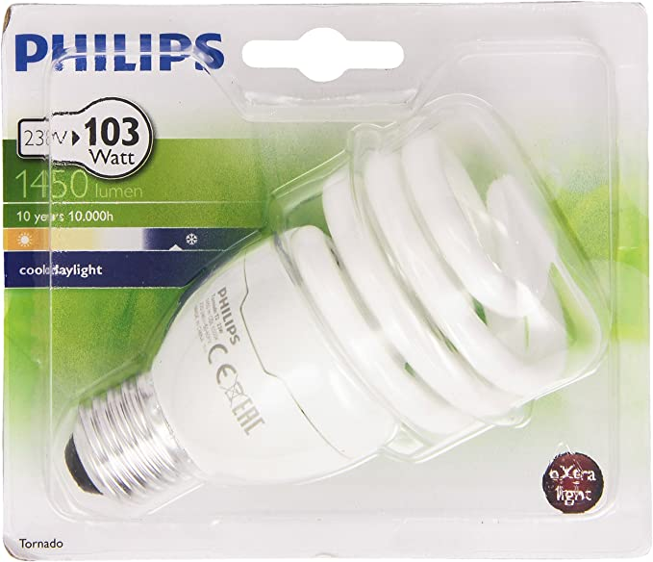
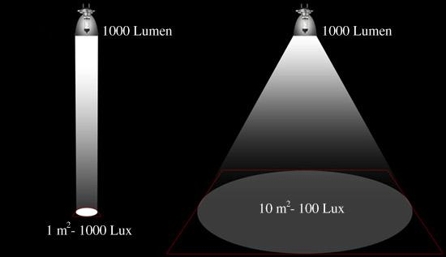
« DSFLI » definition
A bulb, a led module, emit an amount of light expressed in lumen
The illuminance, expressed in lux, is the amount of lumen reaching a given area, divided by the surface of this area: 1 lux = 1 lumen/m² = 1 lm/m²
Light source (bulb, led module) output flux: 1000 lumen
Luminaire output flux: 900 lumen
(luminaire efficiency:90%)
1000m² ⇒ 0.9 lux
1m² ⇒ 900 lux

Slide 2

« DSFLI » definition
THE « DSFLI »: THE TOTAL LIGHT EMITED BY THE LIGHT SOURCES (BULB, LED MODULE), IN LUMEN, INTENDED TO LIT AN AREA IN M²; IT IS NOT AN ILLUMINANCE, IT IS AN ALLOCATION OR QUOTA OF LIGHT
Area intended to be lit:
defined in the Notice issued by the French ministry:
The area intended to be lit corresponds to the useful area which holds movements, people, goods, the lighting of which contributes to promoting safety. Thus, even if illumination of the "surroundings" of the useful surface is desired, they must not be added to the “area intended to be lit” in the calculation of the DSFLI
Light source output: 1000 lm
Luminaire output: 900lm
These two lighting installations show the same « DSFLI »:
1000 lumen produced to lit 100m²
DSFLI = 1000 lm / 100 m²
= 10 lm/m²
0 lux
An area to be lit of 100m²
An area to be lit of 100m²
1m² ⇒ 900 lux
1000m² ⇒ 0.9 lux

Slide 3
« DSFLI » definition
The “DSFLI” sanctions lighting installations that waste light
There, the light is poorly distributed
Here the light overflows excessively from the area to be lit
In both cases, the “DSFLI” concept prevents light source increase or multiplication of light sources; the “DSFLI” challenges to redistribute the light flux in a more efficient way with the same quantity of light
Light source output: 1000 lm
Luminaire output: 900lm
These two lighting installations show the same « DSFLI »:
1000 lumen produced to lit 100m²
DSFLI = 1000 lm / 100 m²
= 10 lm/m²
0 lux
An area to be lit of 100m²
An area to be lit of 100m²
1m² ⇒ 900 lux
1000m² ⇒ 0.9 lux

